Slide 1

“E-Returning System” Submitted for partial fulfillment of Bachelor of Engineering Project Guide: Mr. Prabodh C.P B.E, M.Tech Assistant Professor, Dept of CSE

Slide 2
TEAM INTRODUCTION
1. KASULA THOSHITA
USN : 1SI17CS048
2. R P MANSAWINI JAIN
USN : 1SI17CS079
3. REETHU PRIYA M S
USN : 1SI17CS087

Slide 3
PROJECT SUMMARY
E – Returning system is an integrated system, designed to impart library book returning process in an effective and hustle free way. It helps students to return their books faster without the supervision of librarian and also is an alternate for manual fine collection. This integrated system consists of display, barcode reader, money storage vault and book storage vault. The application software is developed in such a way that it takes restricted input from the user and gets them through. It is completely user friendly.

Slide 4
INTRODUCTION

Slide 5
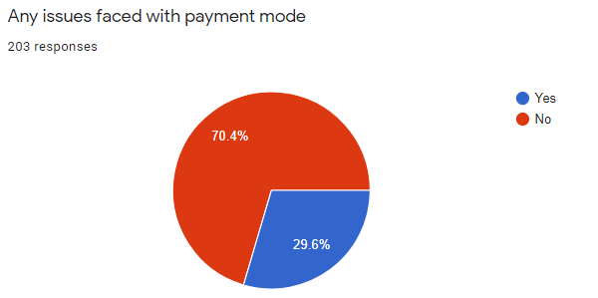
WHY? & HOW?
As a first step of our project we conducted a general survey about the current system and received a good count of 203 responses. The analysis from the responses are:

Slide 6
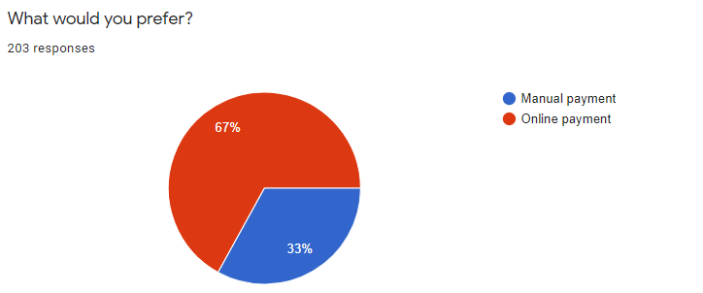
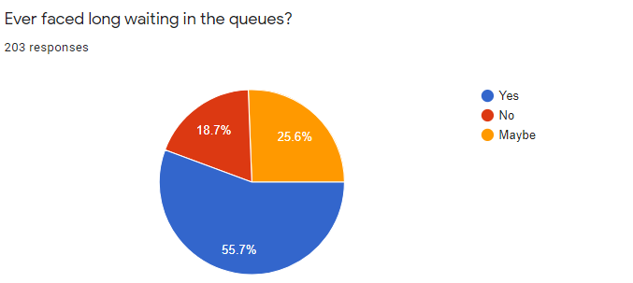
Analysis

Slide 7
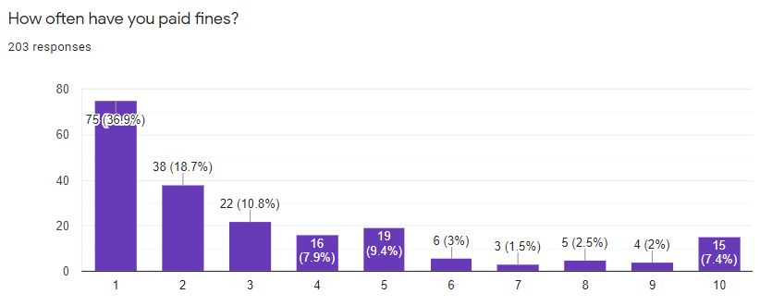
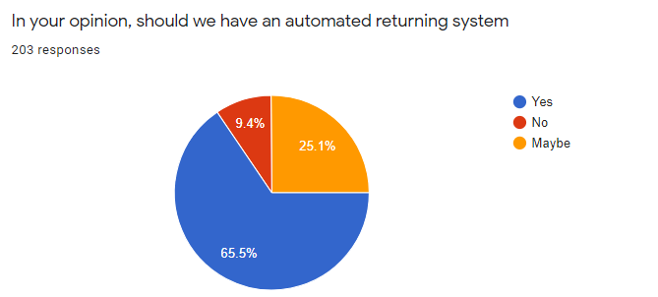
Analysis
1-Rare
10-Very often

Slide 8
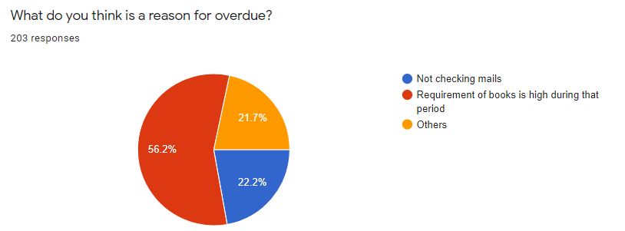
Analysis
Few suggestions we received :
Issuing and returning of books should be made without human intervention as like ATM.
Crowd to be avoided.
Automated system would be much better
Sometimes, even if the book is returned the fine is laid. Got to have a system where this doesn't happen.
Inclusion of online payment. The transaction reference number can be shared while returning the book.

Slide 9
WHY? & HOW?
Why our system?
How are we different from the already existing system services?
In the existing system there are few challenges,
It always needed a person to monitor and collect books, and fines. Hence usage of manual efforts are mandatory.
The average waiting time of a student is around 10-15 minutes and even more depending on the crowd. Hence lack of response time.
There is always a demand for producing exact change during fine payment which often created chaos. Hence exact demand for change every time.
These challenges motivated us with the proposed system.

Slide 10
Proposed System
STEP 1: Input for the system will be the Book Code that is fetched using a barcode reader.
During STEP 1 Book enters a book collection vault. As soon as the barcode is read, information is queried to the database about the book details.
STEP 2: Display the information fetched from the database on screen. Information includes name of the person to whom the book is issued, issued date, due date and fine.
STEP 3: Now, user is provided with two options Accept and Pay or Cancel and back. If user chooses Cancel and back the current transaction is cancelled and is returned to STEP 1. Else, user triggers another request of fine check.
STEP 4: In case fine=0, then a note stating “successful transaction” will be displayed, book will be moved to the book storage vault signifying book acceptance and finally updates database to book returned.

Slide 11
Proposed System
STEP 4: (contd.) Incase if fine>0, user has to input fine amount at the money collection vault.
STEP 5: After money insertion at the collection vault image processing is carried out and the amount inserted will be calculated as value.
STEP 6: Validation of money.
If value=fine, then a note stating “successful transaction” will be displayed, book will be moved to the book storage vault signifying book acceptance, money will be moved to the money storage vault signifying fine acceptance and finally updates database to book returned.
If value>fine, then a note stating “successful transaction” will be displayed, book will be moved to the book storage vault signifying book acceptance, money will be moved to the money storage vault signifying fine acceptance and finally updates database to book returned. Also a sum of value-fine will be returned to the student.

Slide 12
Proposed System
If value<fine, then a note stating “unsuccessful transaction” will be displayed, book will be ejected from the book collection vault signifying book rejected, money will be ejected from the money collection vault signifying fine rejected and finally database remains same.
STEP 7: Back to STEP 1.

Slide 13
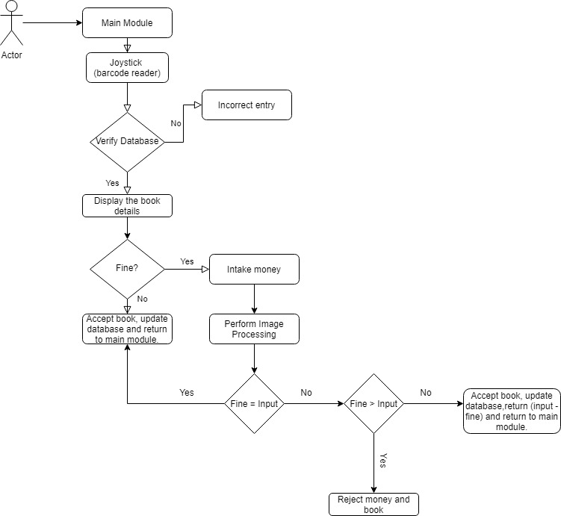
FLOW CHART

Slide 14
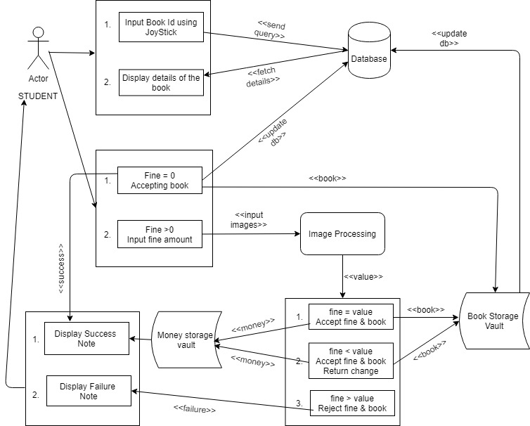
USE CASE DIAGRAM

Slide 15
PREVIEW

Slide 16
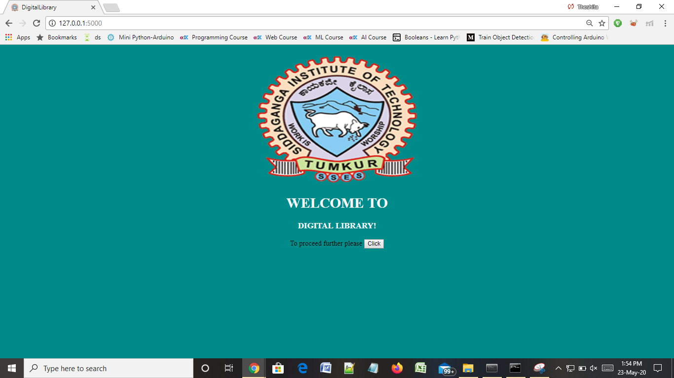
PREVIEW

Slide 17
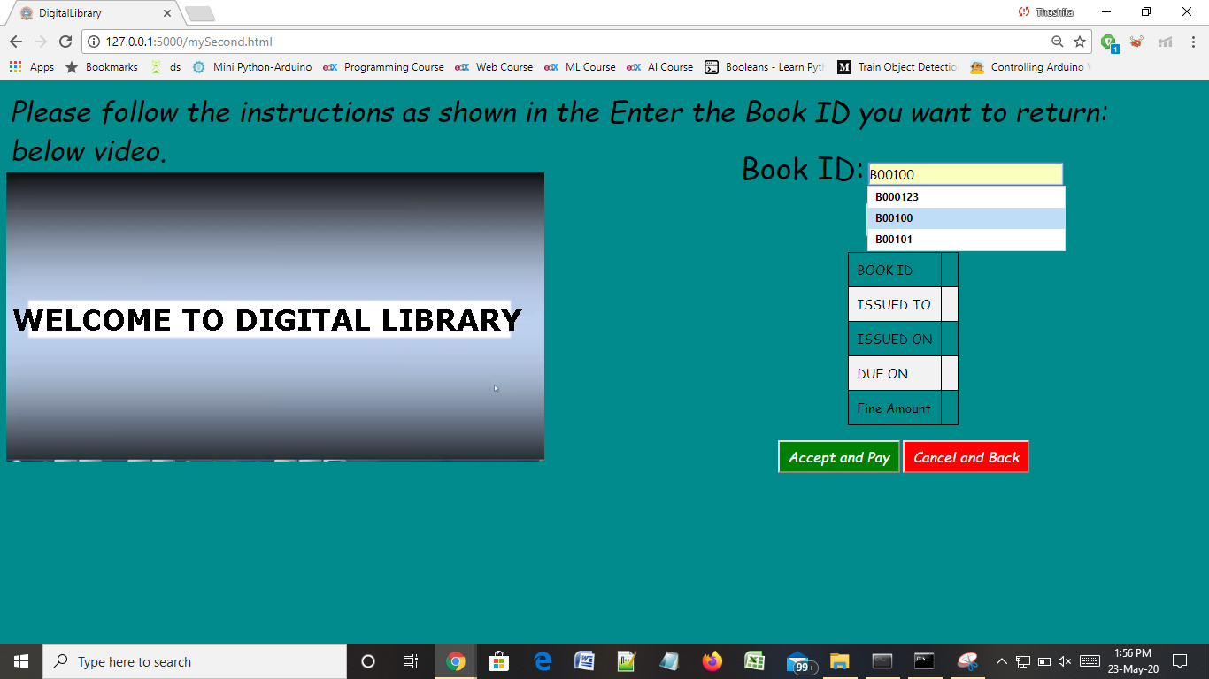
PREVIEW

Slide 18
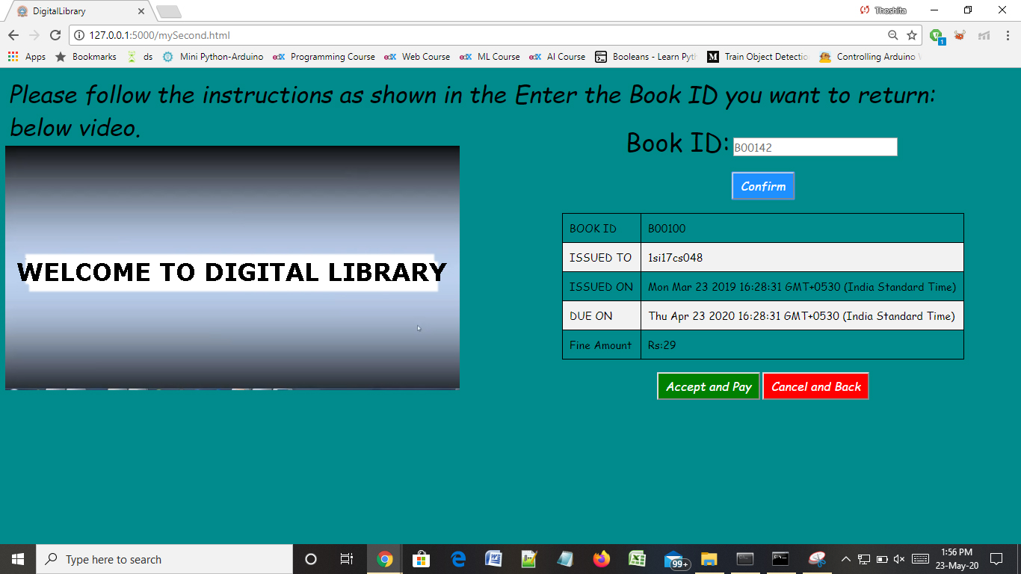
PREVIEW

Slide 19
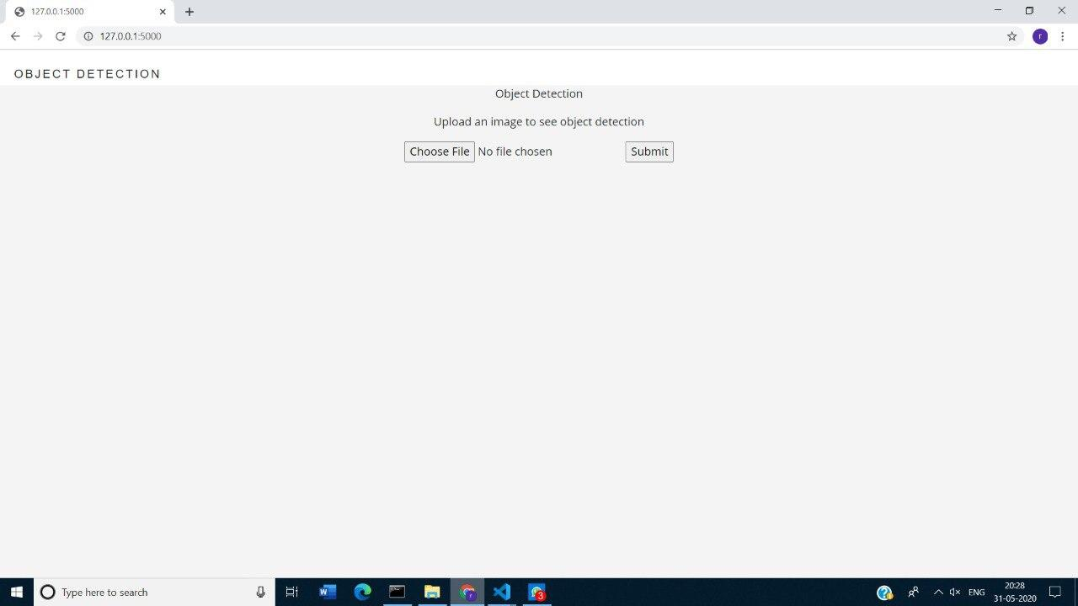
PREVIEW

Slide 20
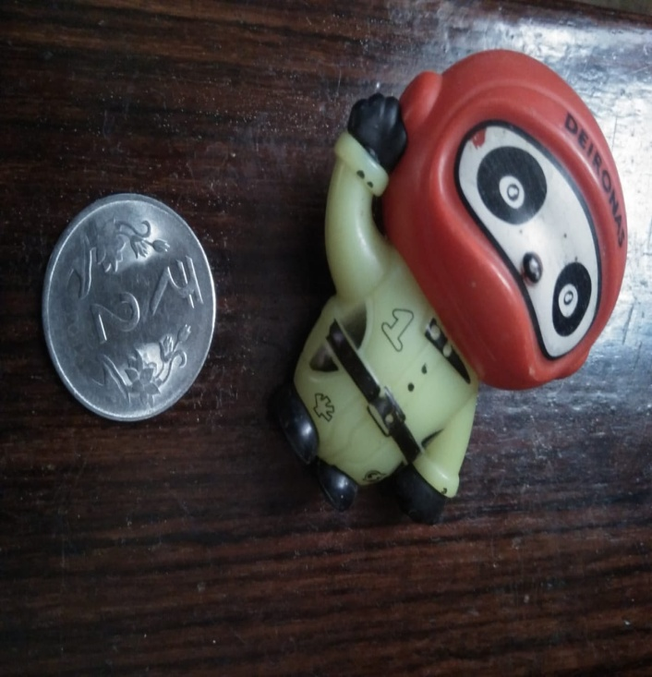
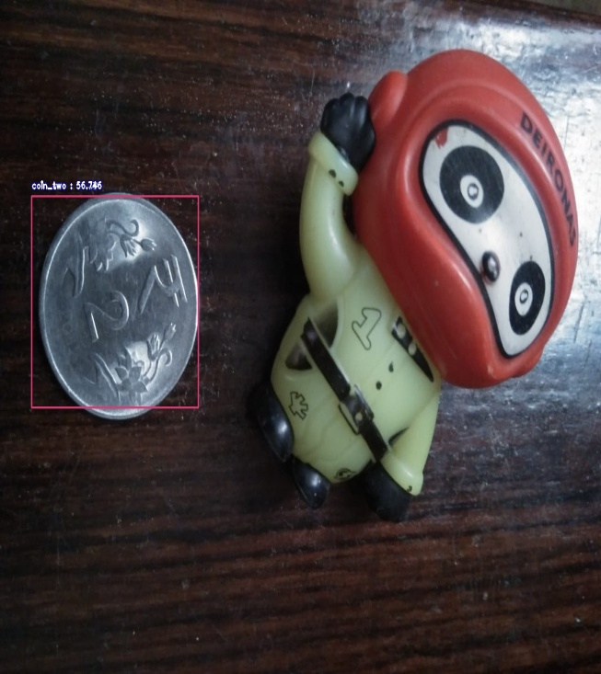
INPUT IMAGE
OUTPUT IMAGE

Slide 21
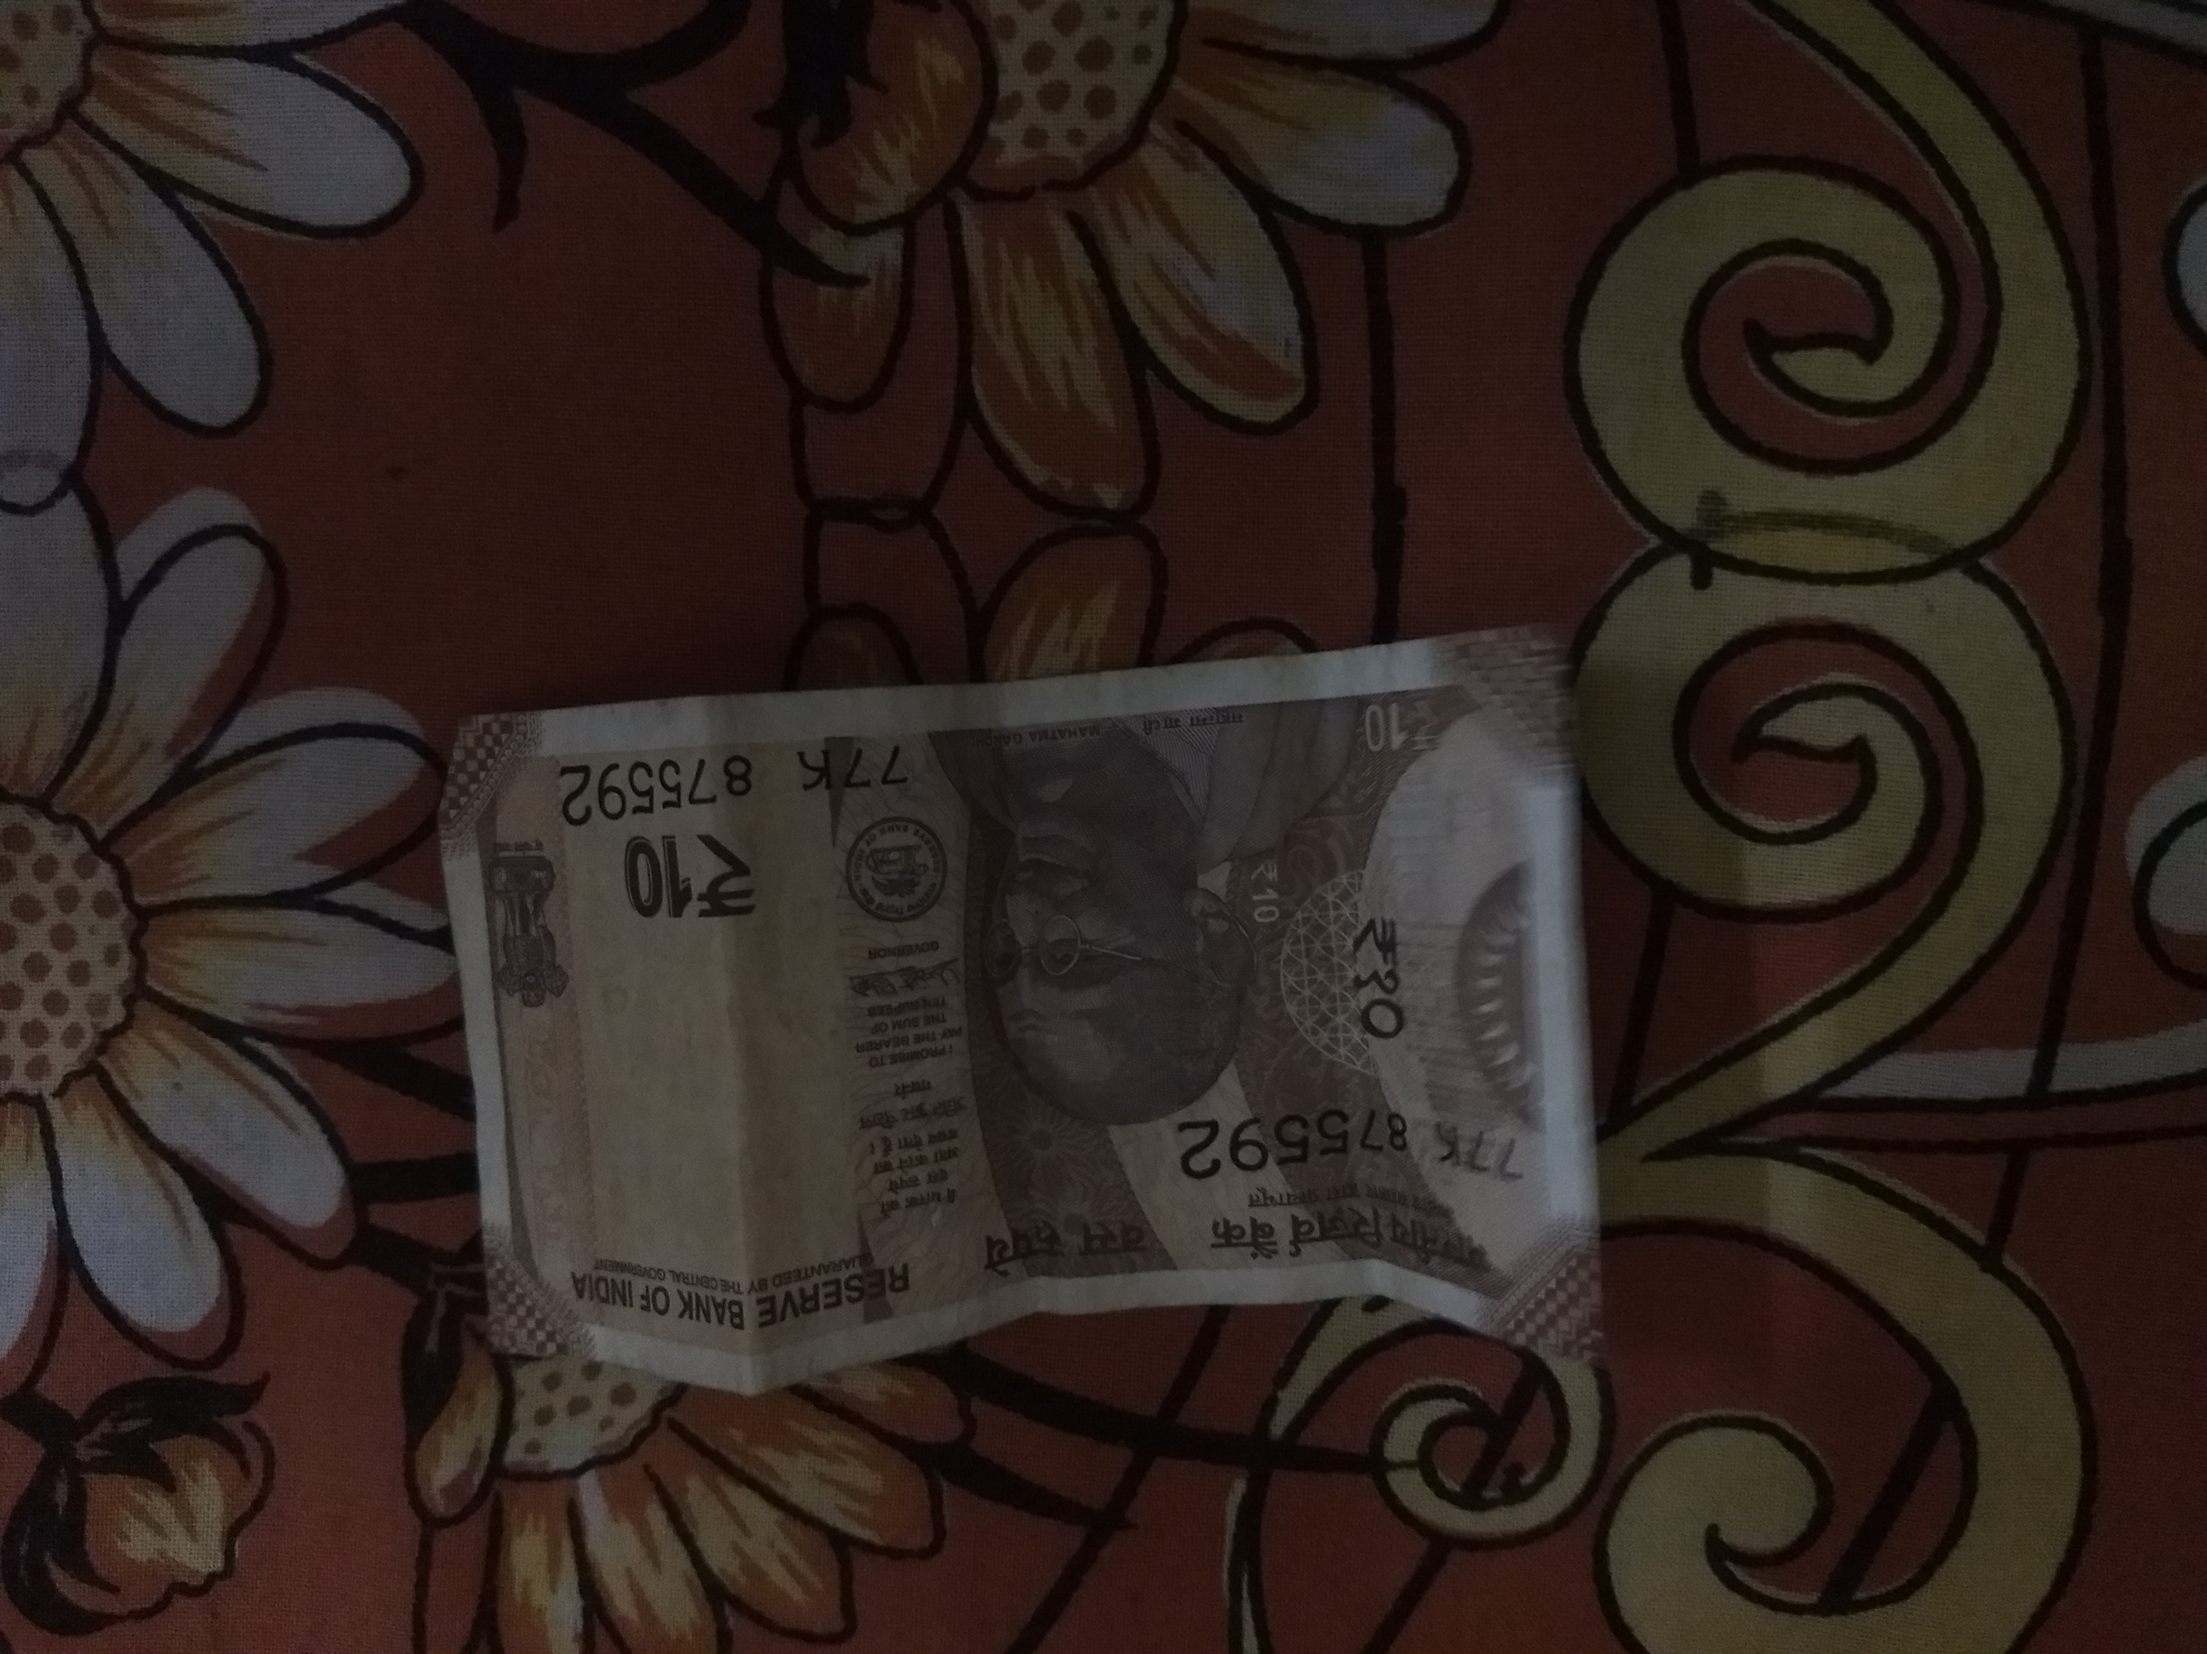
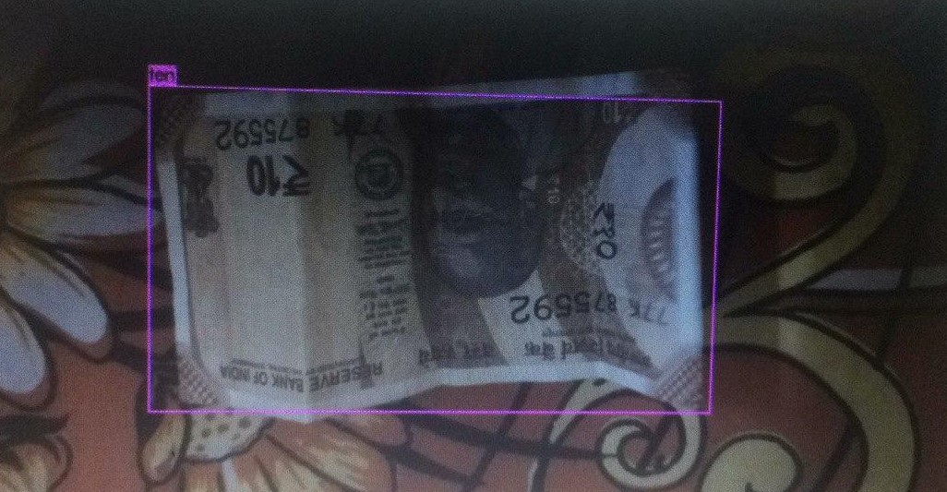
INPUT IMAGE
OUTPUT IMAGE

Slide 22
CONCLUSION

Slide 23
CONCLUSION
It was a wonderful experience for us while working on this project.
This project took us through the various phases of project development and gave us the real insight into the world of software engineering.
The goal of the project was to minimize the manual efforts being put during returning the books as well as to reduce the waiting time in long queues.
In future implementation we are planning to improve the fine collection by interfacing a payment gateway so that even when the machine lacks with proper change to return that wouldn’t lead to another problem.
Also payment gateway will put a stop to problems such as receiving torn notes, fake notes etc.,.

Slide 24
Thank You!

